Slide 1

IT8811- Project work
PREDICTING CYBER-ATTACKS AND IDENTIFYING PERPETRATORS USING MACHINE LEARNING TECHNIQUES
3rd Review
Project Team
Sachin L ( 312820205031)
Dinesh Kumar S ( 312820205009)
Guided By
Dr. G. A.SENTHIL
Associate Professor
Dept of IT
Agni College of Technology

Slide 2
Outline
Abstract and Scope
Introduction
Literature Review
Existing System
Proposed System
Hardware and Software Requirements
Methodology
References

Slide 3
Abstract
The generation of technology has grown significantly in recent years. As a result, as technology advances, the number of crimes also rises. It will result in financial difficulties for the nation and its citizens.
Cyberattacks account for the majority of reported attacks. It will target the privacy data of the people and the nation. As a result, it is challenging to determine what kind of attack would be employed, and the length of the inquiry would also rise.
Numerous systems have been presented that use different machine-learning techniques to analyze and forecast threats. Consequently, we presented the machine learning and regression approach for identifying the assault. It determines the type of cyberattack that will be launched and how to foresee it.
According to our research, the probability of a cyberattack declines as potential victims' income and educational levels rise. We believe that our suggested model will be helpful to law enforcement cybercrime units in identifying and stopping cyberattacks, increasing their efficacy in thwarting these threats.
In conclusion, this study emphasizes how important machine learning is to improving the ability to detect cyberattacks and identify their perpetrators. By employing data-driven insights and advanced analytics, companies can enhance their capacity to anticipate, identify, and mitigate cyber threats, thereby fortifying their defences in a constantly changing digital landscape. Going forward, sustaining a proactive posture against cyber adversaries and safeguarding the security of our global community that is interconnected depends critically on continuous research and machine learning developments.

Slide 4
Objective and Scope of the Project
The escalating threat of cyberattacks in today's digital landscape, covering various challenges globally, from data breaches to malware infections, leading to significant financial losses, reputation damage, and public safety risks. It underscores the necessity for advanced tools to counter cyber threats due to the sophisticated tactics of cybercriminals.
Highlighting Artificial Intelligence (AI) as pivotal, it explains how AI utilizes vast datasets to detect potential cyber threats, employing machine learning techniques for predictive analysis. It elaborates on the process of anticipating cyberattacks, including data collection and preprocessing, development of predictive models using machine learning algorithms, and techniques to address data imbalance.
Furthermore, it explores attributing cyberattacks to perpetrators through digital artifact analysis, stressing collaboration among cybersecurity professionals, law enforcement, and private entities to fortify defenses. Overall, it provides a comprehensive overview of cyber threats, AI's role, anticipation processes, and the importance of collaboration in cybersecurity.

Slide 5
Introduction
The rapid evolution of digital technology has spawned a grave threat of cyberattacks, posing substantial global challenges from data breaches to malware infections, resulting in significant financial losses, reputational harm, and public safety risks. With cybercriminals employing increasingly sophisticated tactics, there's a pressing demand for advanced tools to anticipate and counter such threats.
Artificial Intelligence (AI) emerges as a potent weapon in combating cybercrime, analyzing vast datasets to detect patterns, anomalies, and trends indicating potential cyber threats. Through machine learning techniques, researchers predict cyberattacks, proactively mitigating risks, and strengthening cybersecurity.
Anticipating cyberattacks involves collecting and preprocessing diverse data sources like network traffic logs and historical attack data. Predictive models, tailored to data characteristics, are crafted using various machine learning algorithms, with techniques like oversampling and undersampling to address imbalanced data.
Attributing cyberattacks to perpetrators entails analyzing digital artifacts like IP addresses and malware signatures. Collaboration among cybersecurity professionals, law enforcement, and private entities is essential to refine predictive models and fortify collective defenses against cyber threats. AI plays a pivotal role, but effective collaboration is key in addressing challenges and safeguarding against the evolving cyber threat landscape.

Slide 6
Literature Review
[1] Title: Cyber-attack method and perpetrator prediction using machine learning Algorithms Author: Abdulkadir Bilen and Ahmet Bedri Özer Year: 2021.
[2] Title: Computational system to classify cyber crime offenses using machine learning. Author: R, Gadekallu TR, Abidi MH, Al- Ahmari A. Year: 2020.
[3] Title: Detection of advanced persistent threat using machine-learning correlation analysis, Future Generation Computer Systems Author: I. Ghair, M. Hammoudeh, V. Prenosil, L. Han, R. Hegarty, K. Rabie, F. J. Aparicio-Navarro Year: 2018.
[4] Title: A Machine Learning Framework for Investigating Data Breaches Based on Semantic Analysis of Adversary’s Attack Patterns in Threat Intelligence Repositories author: Zahid Anwar a, b, Asad Waqar Malik a, Sharifullah Khan a, umara Noor a c, Shahzad Saleem a Year: 2019.

Slide 7
Existing System
Data collection : It collect all the data from the user and preprocessing it.
Scalability and Real-Time Processing : It takes more time while the date is large number of sets.
False positive and False negative : We cannot tell give value is accurate or not.
Evolving Attack Techniques : Using of algorithms play an major role.

Slide 8
Proposed System
We used data analysis method, that analyse large set of data in faster manner and that helps to reduce time.
Adversarial learning techniques are used to improve model robustness against adversarial attacks, where attackers try to manipulate the model's predictions.
Gradient Boosting, KNN, Random Forests these algorithms we used. It will give the best prediction method and perpetrator identification.
Graph-based methods model cyber networks as graphs and analyze the relationships between entities to detect suspicious behavior.

Slide 9
Hardware and Software Requirements
SOFTWARE REQUIREMENTS:
Tools : Visual Studio Code, PyCharm
Language : Python, Django, Data Analytics using Python
HARDWARE REQUIREMENTS:
Device : Laptop, Desktop
Operating System : Windows 10,11
Ram : 4 Gb
Storage : 10 Gb

Slide 10
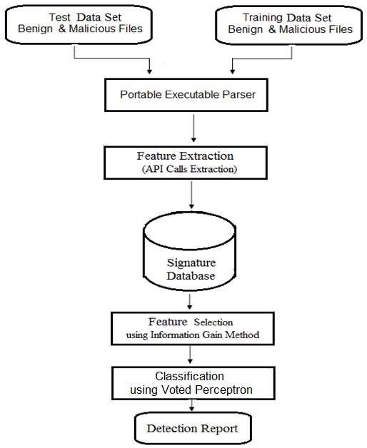
Flow Chart Diagram

Slide 11
Architectural Diagram

Slide 12
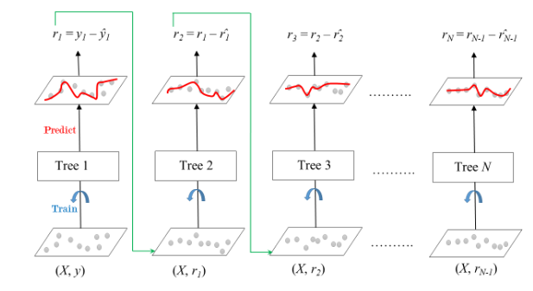
Methodology
Gradient Boosting:
Gradient Boosting is a powerful boosting algorithm that combines several weak learners into strong learners, in which each new model is trained to minimize the loss function such as mean squared error or cross-entropy of the previous model using gradient descent.
In each iteration, the algorithm computes the gradient of the loss function with respect to the predictions of the current ensemble and then trains a new weak model to minimize this gradient.
The predictions of the new model are then added to the ensemble, and the process is repeated until a stopping criterion is met.

Slide 13
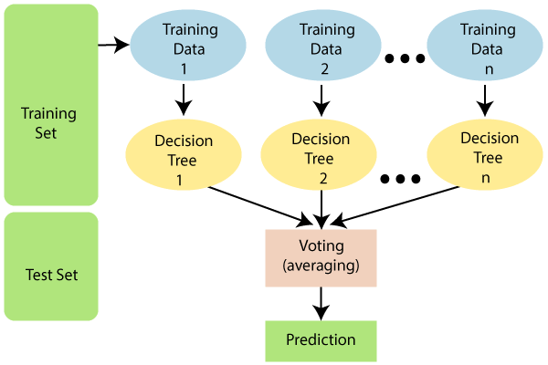
Methodology
Random Forest:
Random Forest is a classifier that contains a number of decision trees on various subsets of the given dataset and takes the average to improve the predictive accuracy of that dataset.
Instead of relying on one decision tree, the random forest takes the prediction from each tree and based on the majority votes of predictions, and it predicts the final output.
The greater number of trees in the forest leads to higher accuracy and prevents the problem of overfitting.
The below diagram explains the working of the Random Forest algorithm:

Slide 14
References
Z. Cui, L. Du, P. Wang, X. Cai, and W. Zhang, ``Malicious code detection based on CNNs and multi-objective algorithm,'' J. Parallel Distrib. Com-put., vol. 129, pp. 5058, Jul. 2019.
Wheeler AP, Steenbeek W. 2020. Mapping the risk terrain for crime using machine learning. Epub ahead of print 24 April 2020.
Arora T, Sharma M, Khatri SK. 2019. Detection of cyber crime on social media using random forest algorithm.
Moorthy RS, Pabitha P. 2020. Optimal detection of phising attack using SCA based K-NN.

Slide 15
Thank You

